Slide 1

Project LocAle
Senior Design Presentation – Fall 2025

Slide 2
Locale – Purpose and Goals
Purpose
Goals
To develop a location-based social media application centered on community engagement.
Bridge the gap between digital media and real-world interaction
Promote connection and creativity in our community through interactive, location-driven content.
Technical Development:
Build a functional web/mobile prototype leveraging geolocation services, media uploading, and interactive maps.
Design & UX
Create an intuitive, visually engaging interface that highlights local art and encourages exploration.
Professional Growth:
Strengthen skills in full-stack development, API integration, and database design.
Practice collaborative software engineering, including version control, testing, and agile workflows.

Slide 3
Project Team
Advisor: Yu Zhao
Zhao3y3@mail.uc.edu
Team members:
Kevin Chu
Computer Science
Chukv@mail.uc.edu
Maggie Lyon
Computer Science
Lyonme@mail.uc.edu
Kate Schmidlin
Computer Science
Schmi2kj@mail.uc.edu

Slide 4
Project Abstract
Locale is a street art–focused social media platform that connects artists and art enthusiasts through location-based media sharing. Users can “leave” photos, videos, or messages at real-world locations, such as murals, installations, or hidden art spots for others nearby to discover. By combining digital creativity and physical exploration, Locale encourages users to engage with their surroundings by uncovering local art and participating in meaningful community discussions. Artists can share their work in context and track engagement, while users can follow their favorite creators, transforming everyday spaces into interactive galleries that celebrate local creativity and connection.

Slide 5
User Stories
As a user, I want to discover media left at nearby locations so that I can explore interesting content while engaging with my local environment.
As a user, I want to interact with posts that others have left in my area so that I can participate in local discussions and feel part of the community.
As a content creator, I want to post photos, videos, or messages at specific real-world locations so that people visiting those spots can experience my content in context.
As a content creator, I want to see how many users have discovered and interacted with my location-based posts so that I can understand my impact and reach.
As a user, I want to follow content creators whose location-based posts I enjoy so that I can see more of their content when I explore.

Slide 6
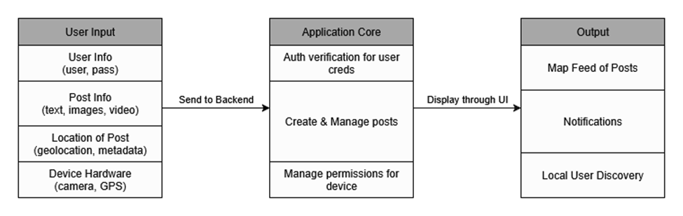
Design Diagram 0
Notes:
Design Diagram D0 depicts the locale system at the highest level. The functional blocks in
this diagram depict the input and output of the tool, as well as the basic internal
functionality.
Information is taken from user input such as usernames and passwords
Post information is also taken such as the text, images, and videos that are a part of the post
The location information is taken from the devices’ geolocation and media’s metadata
Information from the user’s hardware will also be taken
Then is sent to the backend where the application core will use that information in its functionalities
User authentication is one of the functionalities within the application core; it allows for users to securely log in to their accounts
The creation and management of posts are also handled in the application core using the post and location information
Device permissions are handled as well to extend the functionality to the users’ device

Slide 7
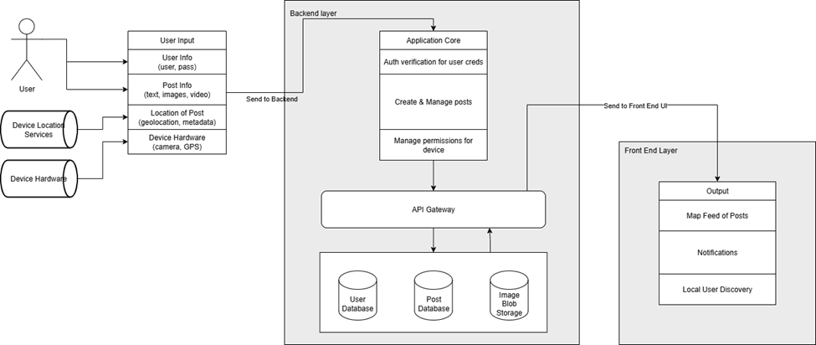
Design Diagram 1
Notes:
Design Diagram D1 details some of the specific modules the Locale system will contain.
Building upon the input/output/application core model from D1, this diagram shows the
basic flow of data through the system. User and device data flow into the application core,
where they are processed and stored accordingly. Data is returned by the application layer
to the front end as visual outputs that the user may interact with. In this diagram, boxes
represent functional modules, and arrows depict the flow of data through the application.

Slide 8
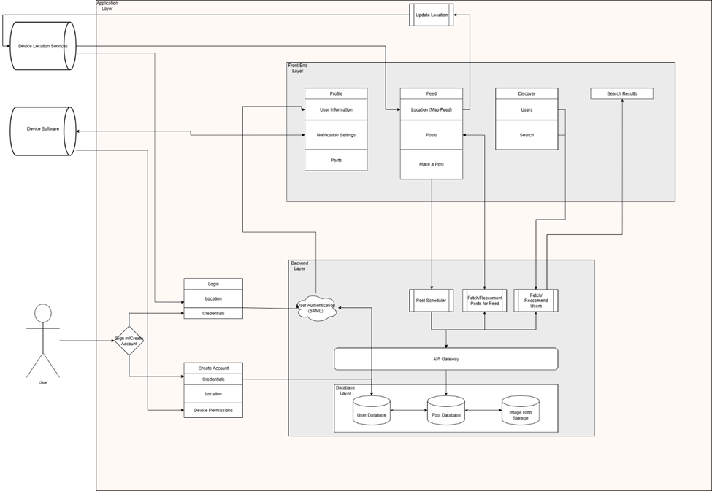
Design Diagram 2
Notes:
Design diagram D2 breaks down some of the functional modules of the Locale system. In
this diagram, shaded boxes represent different functional areas of the application. The
outer most box is the application layer, with any data traveling into it representing user
input. Within the application layer are three major functional areas – user authentication,
the front-end layer, and the backend layer. Once a user data is authenticated, it flows to
one of many front end components, which perform calls to the database to fetch data via
processes communicating with the databases API layer

Slide 9
Project Constraints
Ethical
Ensure non-participants security and anonymity
Preventing graphic images from being uploaded to the applications
Accessibility
Users from multiple backgrounds and skill levels with technology must be able to access application
Multiple language options
Responsive and Accessible UI
Security
Protect account and location information for users
Data security for personally identifiable information

Slide 10
Project State
Completed Work
Preliminary Design Deliverables
Branding and Visuals
UI Mockups
Repo Setup
Environment/Framework Decisions
React Native, MongoDB, TailwindCSS
Next Steps
Boilerplate Code

Slide 11
Expected Accomplishments
To be accomplished this semester
Boilerplate code generation
Dual Repo (separate frontend/backend) style
Full Information Architecture
Sync with UI Mockups
Database Schema Generation

Slide 12
Division of Future work
The remaining work to be completed this semester will be delegated as follows:
Boilerplate code generation
Maggie Lyon
Information Architecture/UI Mockups
Kate Schmidlin
Database Schema Generation
Kevin Chu
Development Work completed next semester will be agile in nature and assigned based on workload as we see fit

Slide 13
Planned Demo
At the completion of Spring Semester, we hope to have a functioning web app that:
Allows users to create a profile and make and interact with posts
See art in 3d in Augmented Reality
Interact with other users in the geographical region
The primary focus of this demo will be the augmented reality function of this tool

